Slide 1
Workout Tracker
CS 232 Final - Peter Boster

Slide 2
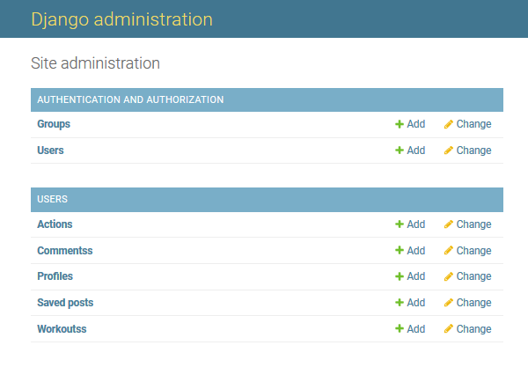
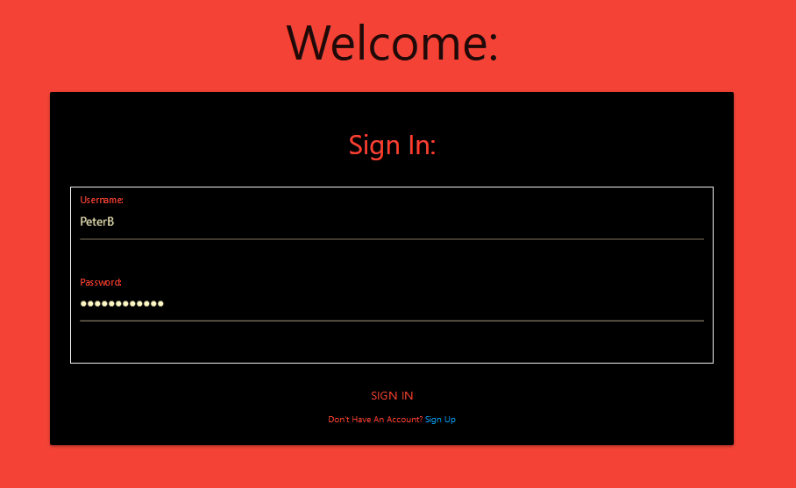
Coolest Part
Although I did not write them, I think the login and admin system is really cool. I also really appreciate the built in hashing and admin view of the database.

Slide 3
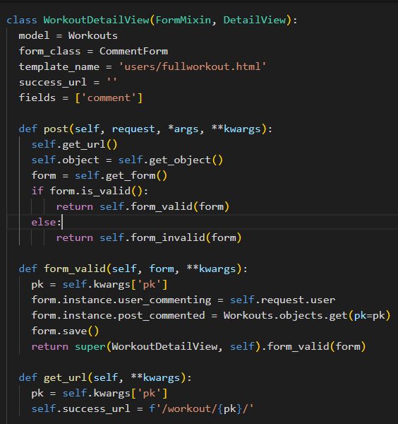
Code I am Most Proud of
The commenting feature
The way I designed my views, this was the most difficult feature for me to figure out by far
Hard to get a the detail view which represents one database table (Workouts), display a ‘list view’ of the comments, and a form to update another table (Comments).

Slide 4
If I could do it all over again, I would…
Start my projects sooner/balance my workload better. I devoted a lot of focus to this project at the beginning, but I stopped working on it for a bit to do my 211 project.
Design my database better/think out my views better. Bad design can lead to a lot of tech debt that makes it harder to fix and/or add things later.
Learn more about frontend design. Outside of the scope of this class, but I feel pretty weak in this area and would like to get better.

Slide 5
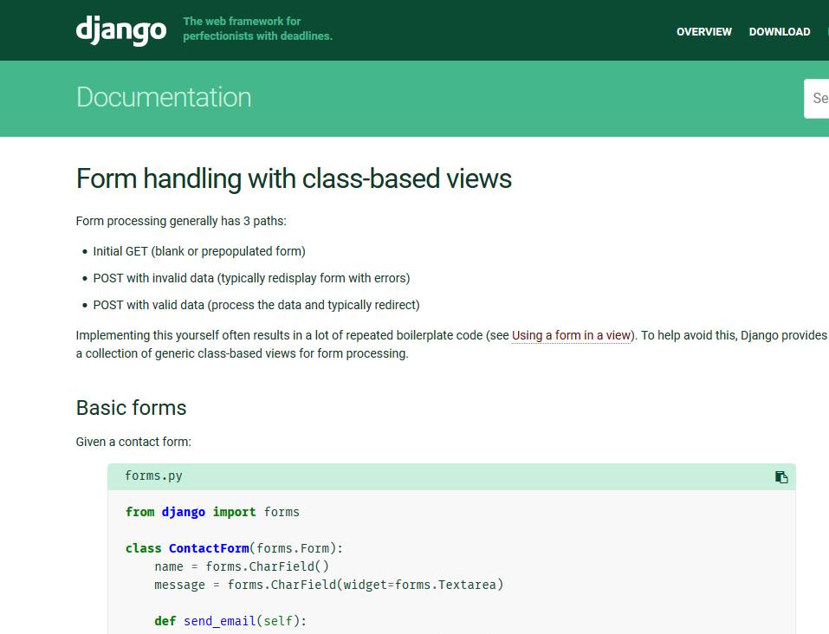
The thing that I learned the most was…
Bad design = Harder to fix
This really got me when I tried to implement comments on posts because my design is very poor.
Reading documentation.
A lot of my time was spent on the official Django documentation and so the importance of knowing how to read the docs is another big thing I re-learned.

